Slide 1
Multi-Report
Quick Start Guide

Slide 2
What is Multi-Report?
Multi-Report was written a long time ago under a different name, with the purpose of augmenting FreeNAS 8.x (and beyond) for running SMART tests, monitoring for drive failures as FreeNAS was not very good at it reliably.
To this day it is still augmenting for some shortcomings (scheduling NVMe drive SMART test), and to make people feel a little safer knowing the testing is going on and alarms will be generated if needed.
SMART was designed with the intention to warn a user of pending doom within 24 hours of a failure. I will take any amount of time I can get but it could have been 2 hours or no hours as well. There are some failures that cannot be predicted and some failures happen very fast. All the data provided by this script will assist you moving forward once a failure or indication of a pending failure is identified.
Additionally, I highly recommend running a SMART Short test once a day and run a SMART Long test once a week. If you have a lot of drives, only schedule a few drives a day (Monday), a few others (Wednesday), you get the point.
As you look at the chart data, note that the column titles should be self-explanatory.

Slide 3
Quick Setup Information
Place script on your server (location is for an example)
Create a new dataset titled ‘scripts’. Path: /mnt/pool/scripts
Make the dataset:
Name: scripts
Share Type/Dataset Preset: SMB
SCALE: Create SMB Share checkbox
Submit/Save
You should now have access to the SMB share.
Copy the script to the ‘scripts’ dataset, rename the script to “multi_report.sh”.
First and Second Run
As a privileged user, open a shell/SSH window and change directory ‘cd’ to cd/mnt/pool/scripts
First Run: Enter ./multi_report.sh -config
Follow the instructions to create a multi_report_config.txt (configuration file).
Second Run: Enter ./multi_report.sh
The script should run without error.
Notes:
To customize Multi-Report run the script with the ‘-config’ switch and select Advanced Configuration. There are a large amount of things which can be customized for almost every situation.
In order to run SMART Self-tests on NVMe drives, you must set NVM_Smartmontools_74_Override=“enable“. You can manually edit the multi_report_config.txt file or use the Advanced Configuration section.
If you run into a real problem, search the TrueNAS forums first, and if you cannot figure it out, use the ‘-dump email’ switch to send me the required information I need to assist you. I will return an email to you once I have looked at it. I normally get back to people in less that 24 hours, keep in mind time zones, I’m in the USA, NY (ET).
Setting up the CRON JOB
Tasks -> Cron Jobs -> ADD
Description: multi_report
Command (CORE): ./mnt/pool/scripts/multi_report.sh
Command (SCALE): cd/mnt/pool/scripts && ./multi_report.sh
Run As User: root (or any privileged account)
Schedule: Custom
Preset: Daily
Minutes: 0, Hours: 2, Days: *
Select DONE
Hide Standard Output: Unchecked
Hide Standard Error: Unchecked
Enabled: Checked
Save

Slide 4
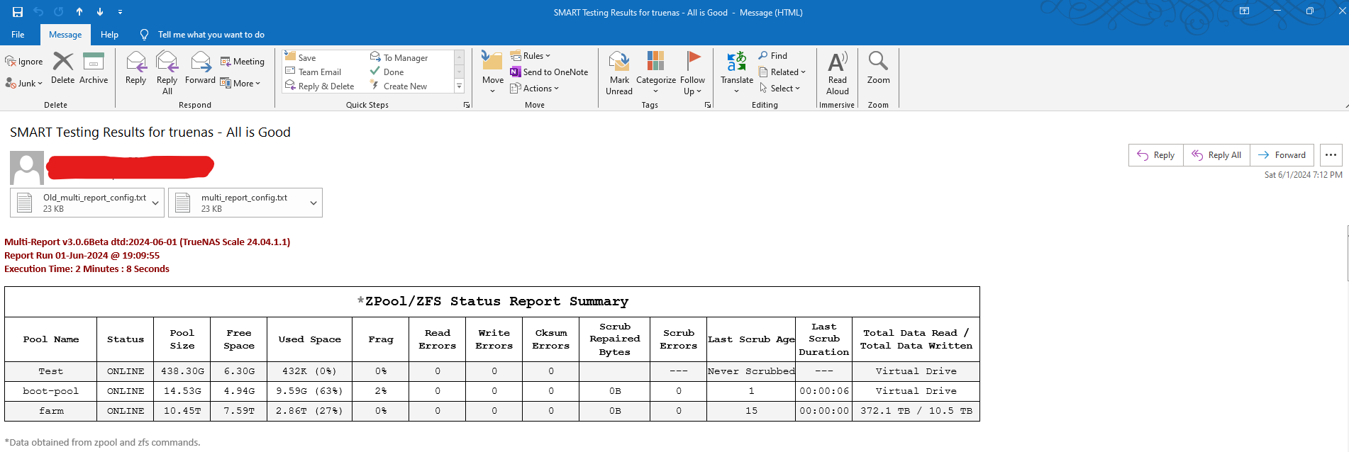
Anatomy of the Multi-Report Email
Subject Line with Summary
Old and Current configuration files after an upgrade
Version Info (Red if “Beta”)
Date/Time of Report
Duration of the Script
Total Lifetime Data Values for all the drives in a pool.

Slide 5
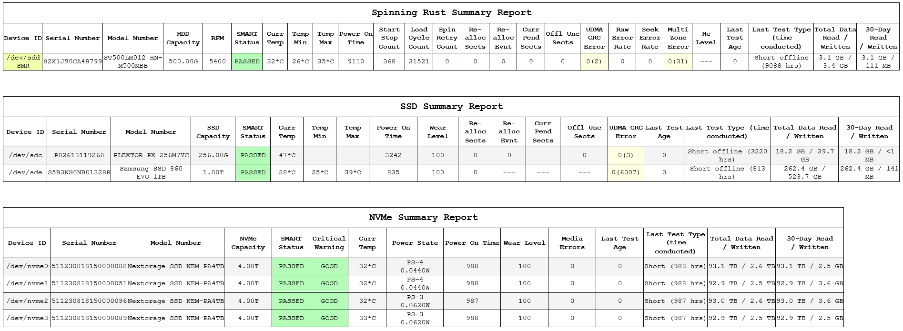
Anatomy of the Multi-Report Email
“0” = Compensation Value
“(2)” = Real Value, Yellow = Alarm Override
Purpose: To easily monitor future alarms
30 Day Rolling Average, can be set to Calendar Month
SMR Checking
Yellow = Alarm Override
Total Lifetime Data Read or Written to the drive
The power state of the NVMe when the script is near completion
How many 24 hour periods have past since last S.M.A.R.T. test
A Short S.M.A.R.T. Test Completed
(987) Hours the test completed. If the last test was a Long test, that would be indicated here

Slide 6
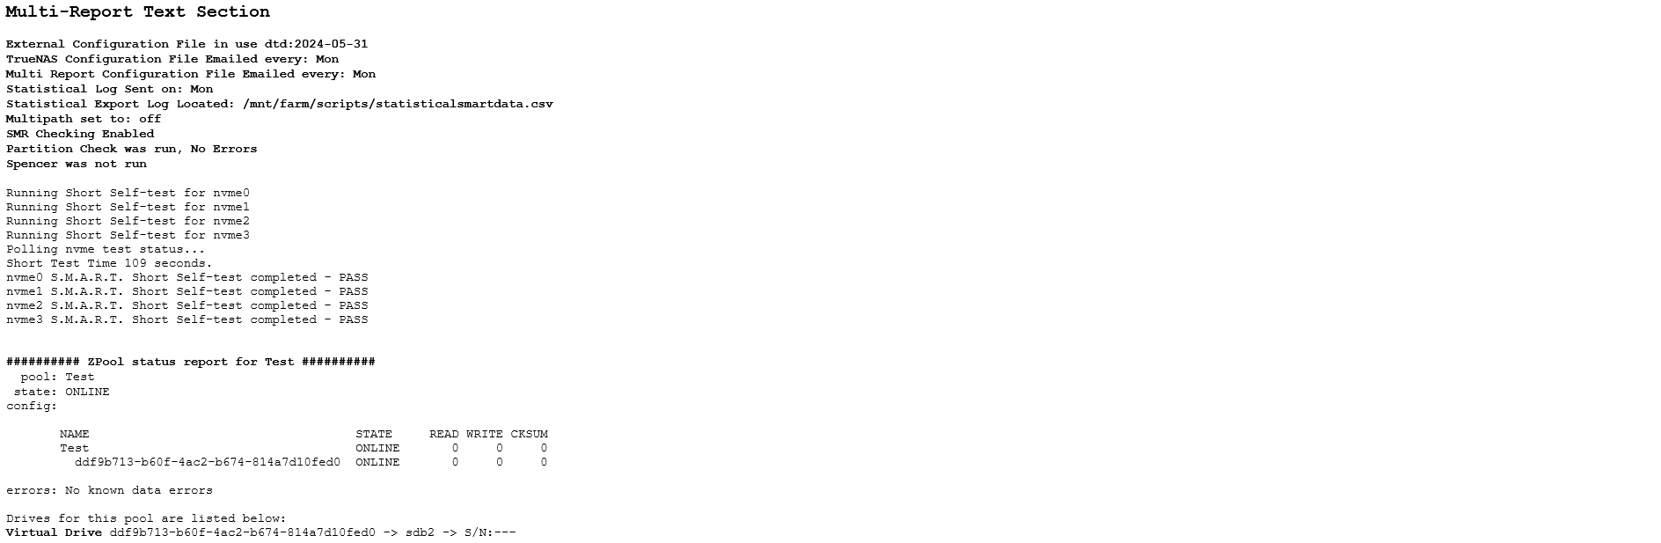
Anatomy of the Multi-Report Email
The Text Section contains:
Configuration Information
Test Information
and
Error Information
If you have an alarm on the Chart Section, look here for amplifying information.
Zpool Status
This tells you the drive is “Virtual”, the gptid number, the Drive ID, and Drive Serial Number.
Use this data to help identify a failing drive.

Slide 7
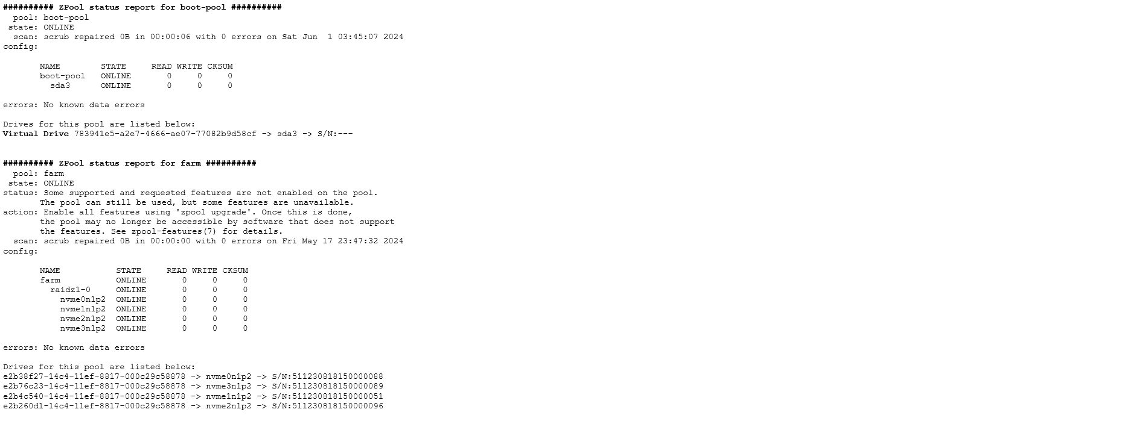
Anatomy of the Multi-Report Email
All drives for the “farm” pool are listed and identified by three things:
gptid -> Drive ID -> Drive Serial Number
This makes it significantly easier to identify which drive actually failed by serial number.

Slide 8
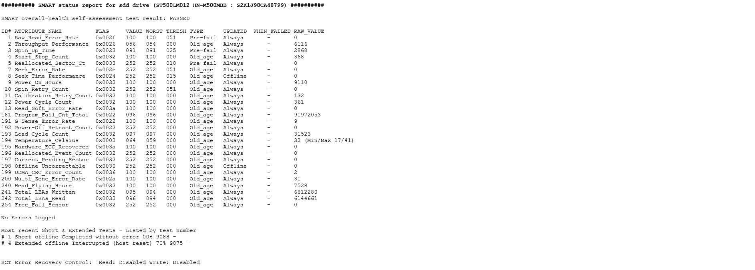
Anatomy of the Multi-Report Email
Header to identify the report is for Drive ID ‘sdd’ and lists the Model Number and Serial Number
Lastly we have the OUTPUT of “smartctl –a”
Why did I include this in the report you ask?
Because the more information we have to analyze, the better our decision is on what actions, if any, are required.
The Last SMART Short and Long Tests
with the results.
TLDR Can also be set by the script, the default is 70 (7.0 seconds) when enabled. It is Disabled in this example.

Slide 9
Closing Notes
Always backup your important data.
Always use an Uninterruptable Power Supply (UPS).
Read the User Guide (I need to update it again).
Always celebrate May the 4th “be with you”. Yea, corny.
If you find something wrong with the script or these instructions, please reach out to joeschmuck2023@hotmail.com with the issue, or run the script using the ‘-dump email’ switch to send me data to analyze and include a little message as well. Believe it or not, I appreciate the feedback, good or not so good.

